Slide 1

The Palate of atlanta
By Sayantan Dutt
May 2020

Slide 2
Business Problem
Atlanta is the capital, most populous, most ethnically diverse and largest city of the U.S. state of Georgia. With an estimated 2018 population of 498,044, it is also the 37th most populous city in the United States.
Food diversity is naturally an important part of such an ethnically diverse city. Restaurant business is hence one of the lucrative business opportunities in Atlanta, the city being home to a large and diverse population and with a heavy tourist foot fall.
The purpose of this project is to analyze the various neighborhoods of Atlanta to assist restaurateurs to decide on the perfect location for by being able to answer the following questions -
What are the most top 10 populous neighborhoods in Atlanta?
What are the top 5 favorite cuisines in Atlanta neighborhoods?
What are the locations suitable for these cuisines?

Slide 3
Data Preparation
Wikipedia - Atlanta Neighborhood
https://en.wikipedia.org/wiki/Table_of_Atlanta_neighborhoods_by_population
Foursquare API
venues (search) - This endpoint returns a list of venues near the current location,
venues (explore) - This endpoint returns a list of recommended venues near the current location
Geopy Client
The coordinates of the Atlanta neighborhoods have been obtained using geocoder class of Geopy client.

Slide 4
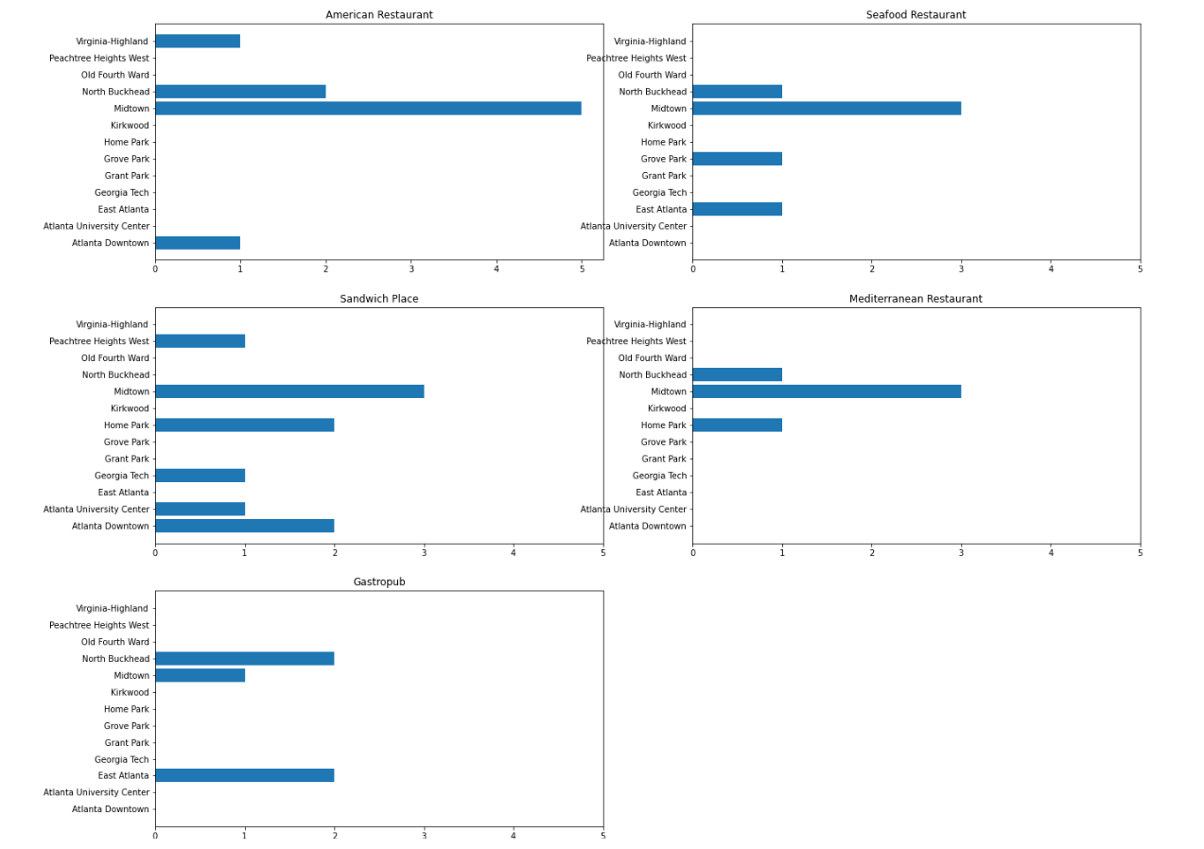
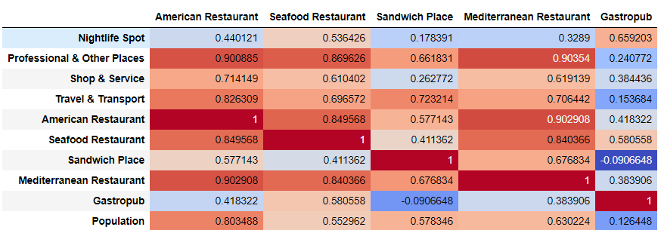
Food categories analysis
The top 5 categories are plotted for each neighborhood.
Midtown has the highest concentration of almost all the top5 cuisines.
The correlation of each of the top 5 food categories with the existence of other venues and population in each neighborhood is illustrated by this correlation map.

Slide 5
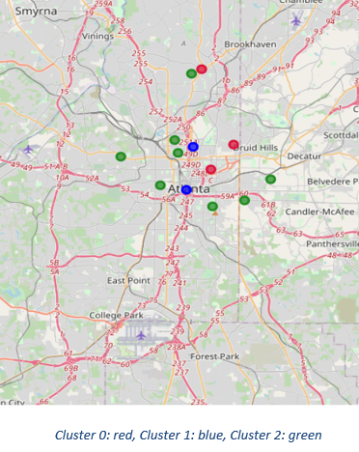
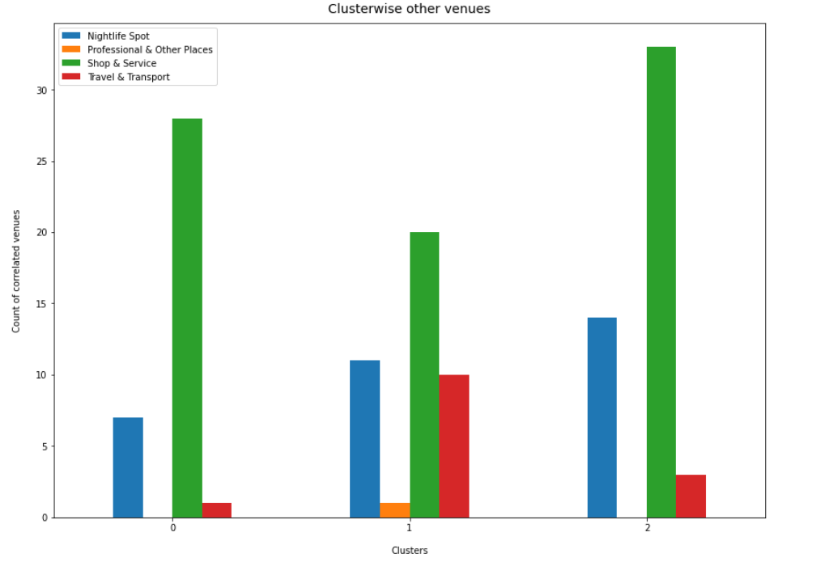
Clustering of Neighborhoods
The count of other venues (that are correlated with food) are illustrated below
The neighborhoods are segmented into 3 clusters (using k-means technique)

Slide 6
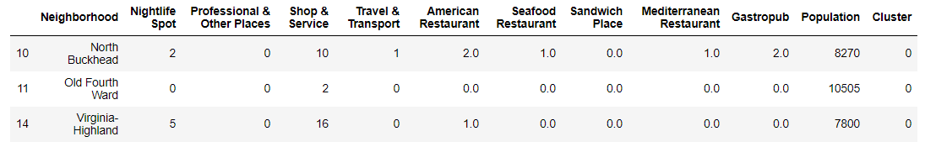
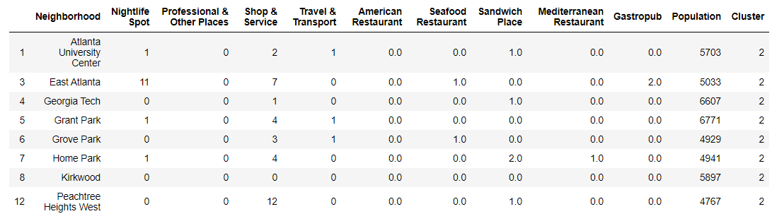
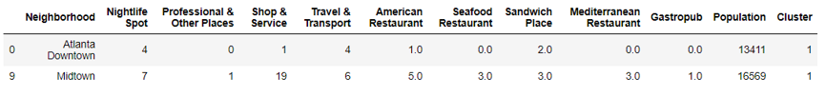
In-depth view of the clusters
Cluster 0 Cluster 2
Cluster 1

Slide 7
Location Recommendation
In Cluster 0, Virginia-Highland can be considered the best location for starting Seafood Restaurant or Gastropub business, as this neighborhood has Nightspots and Shop Service venues centers, all of which have warm correlation with Seafood / Gastropub cuisines. But Virginia-Highland has no Seafood / Gastropub restaurant, hence there will be no competition at all.
In Cluster 1, Atlanta Downtown can be considered the best location for starting Seafood Restaurant or Mediterranean restaurant business, as this neighborhood has 4 Travel & Transport venues, which has warm correlation to Seafood / Gastropub cuisines. But Atlanta Downtown has no Seafood / Gastropub restaurant, hence there will be no competition at all.
In Cluster 2, Grant Park and Grove Park can be considered the best location for starting American Restaurant business, as this neighborhood has moderate Shop & Service venues and1 Travel & Transport venues each, which has warm correlation with American Restaurant cuisines. But Grant Park and Grove Park has no American restaurant, hence there will be no competition at all.
Cuisine Category | Recommended location
American Restaurant | Grant Park , Grove Park
Seafood Restaurant | Virginia-Highland , Atlanta Downtown
Mediterranean Restaurant | Atlanta Downtown
Gastropub | Virginia-Highland

Slide 8
THANK YOU

